Slide 1
INTELLIGENT DECISON SUPPORT
(ARTIFICIAL NEURAL NETWORKS)
(#7)
Prof. Dr. Ercan Oztemel

Slide 2
CONTENTS…
Definition
Biological vs. Artificial Neurons
Processing Element
Applications
İnformation processing in neural networks
Learning strategies and rules
Design issues in neural networks
Learning
XOR problems
A Business example

Slide 3
Neural Networks
Artificial neural networks are computational paradigms based on mathematical models that unlike traditional computing have a structure and operation that resembles that of the mammal brain.
Artificial neural networks or neural networks for short, are also called connectionist systems, parallel distributed systems or adaptive systems, because they are composed by a series of interconnected processing elements that operate in parallel.
Neural networks lack centralized control in the classical sense, since all the interconnected processing elements change or “adapt” simultaneously with the flow of information and adaptive rules.

Slide 4
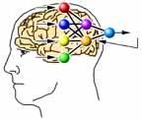
Neural Networks
Similarity of biological and neural networks

Slide 5
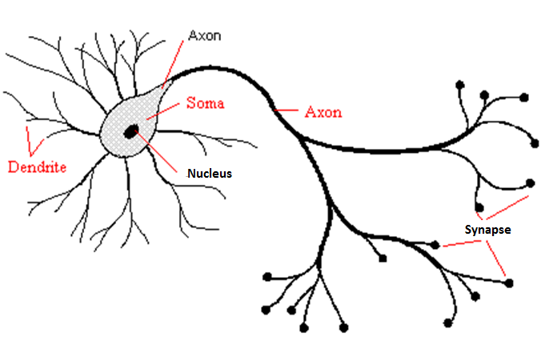
Biologic Neuron- Mammalian neuron
1. The majority of neurons encode their
outputs or activations as a series of
brief electical pulses (i.e. spikes or
action potentials).
2. Dendrites are the receptive zones that
receive activation from other neurons.
3. The cell body (soma) of the neuron’s
processes the incoming activations and
converts them into output activations.
4. Axons are transmission lines that send
activation to other neurons.
5. Synapses allow weighted transmission
of signals (using neurotransmitters)
between axons and dendrites to build
up large neural networks.

Slide 6
Artificial Neuron- Process elements
Input 1
Weight 1
Input 2
Weight 2
Activation
Summation
Function
Function
Output
Input 3
Weight 3
( NET)
..
F (NET)
..
..
Input N
Weight N

Slide 7
Examples of summation functions

Slide 8
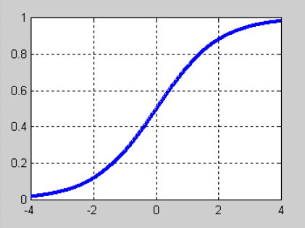
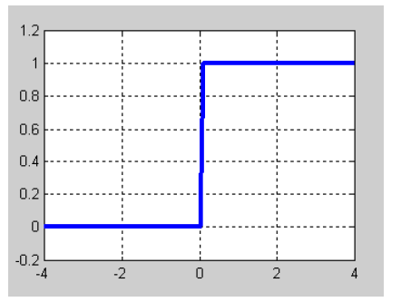
Examples of activation function
Sigmoid
Lineer
F(NET)= NET
Step fonksiyonu
1 if NET > Threshold
F(NET) =
0 if NET <= Threshold
{
Sinus
F(NET) = Sin (NET)
Threshold function
0 if NET<= 0
F(NET) = NET if 0<NET< 1
1 if NET>=1
{

Slide 9
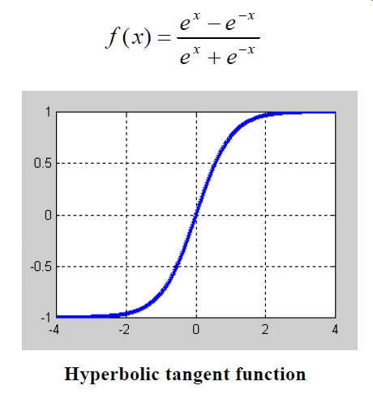
Examples of activation function

Slide 10
Neural network identifiers
Summation function
Activation function
Learning rule
Learning strategy
Network topology

Slide 11
Examples of neural network models
· Single layer perceptron
· Multilayer perceptron
· Learning vector quantization network (LVQ)
· Self organizing networks (SOM)
· Adaptive Resonance Theory (ART)
· Hopfield Network
· Counter-propagation Network
· Neo-cognitron Network
· Probabilistic Network
· Elman Network
· Radial Basis Network

Slide 12
MLP topology- single hidden layer

Slide 13
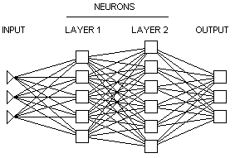
MLP topology- multi hidden layer

Slide 14
Information Processing in Neural Networks
Neural Network
Hidden Layer
Output Vector-> Y = (Y₁, Y₂, , Y₃, Y₄, Y₅, Y₆, ...) ^{T}
Input Layer
Output Layer
Input Vector->X = (X₁, X₂, , X₃, X₄, X₅, X₆, ...) ^{T}
Inputs
Output
X
Y

Slide 15
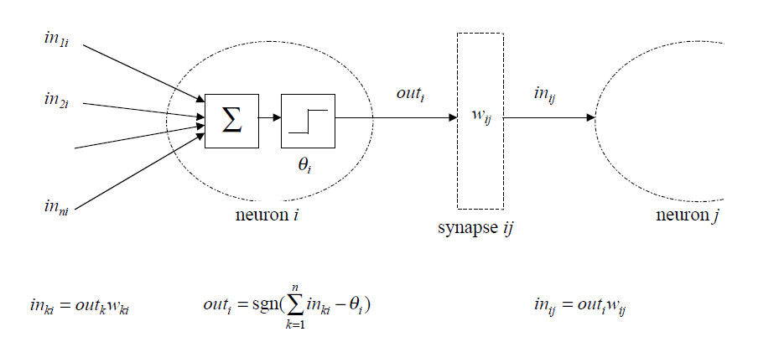
Information processing in each process element

Slide 16
Characteristics of neural networks
Learns from examples
Processes only numeric information
They are taught before working
Good in pattern recognition and classification
Adaptive and self-organizing
Works with missing knowledge and becomes fault tolerance
Capable of working real time with high speed of knowledge processing
Have distributed memory
Performs graceful degradation

Slide 17
Shortcomings of neural networks
Dependent upon hardware
Difficult to find out proper network for every problem
No rules to identify the network parameters
Working only with numeric information.
Not assuring optimum results
No specific stopping criteria
No possibility to explain reasoning process.

Slide 18
Learning
Learning: Improving behavior through time.
Machine learning: Having computers to process knowledge possessed and improving the content by utilizing any learning algorithm and strategy
Learning in neural networks: Learning event by using known examples and provide interpretations of unknown events through similarities.

Slide 19
Knowledge of neural network
Knowledge of neural network is represented by the weight values of the connections. It is distributed all over the network.
Defining the right values for the weights is essential to provide the right outputs. Finding out the right values for mapping specific set of inputs to specific set of output is called “learning”. Initial values are set randomly and changed during learning process according to a learning rule. The amount of change in each iteration is defined by a learning coefficient.
A NN is said to be taught if it produces the right outputs for the inputs in the training as well as testing set.

Slide 20
Learning Rules
Hebian rule
Generalized delta rule
Hopfield rule
Kohonen rule
.Grosberg rule

Slide 21
Learning strategy- Supervised learning
Supervised learning: a suprevisor tells the network what to learn.
The network is trained using a set of input-output pairs. The goal is to ‘teach’ the network to identify the given input with the desired output. For each example in the training set, the network receives an input and produces an actual output.
After each trial, the network compares the actual with the desired output and corrects any difference by slightly adjusting all the weights in the network until the output produced is similar enough to the desired output, or the network cannot improve its performance any further.

Slide 22
Learning strategy- Reinforcement Learning
Reinforcement learning: Supervisor only tells whether the output of the network is true or false.
Similar to supervised network except no desired output is specified.

Slide 23
Learning strategy- Unsupervised learning
Unsupervised learning: Learning without any help of a supervisor
The network is trained using input signals only. In response, the network organizes internally to produce outputs that are consistent with a particular stimulus or group of similar stimuli. Inputs form clusters in the input space, where each cluster represents a set of elements of the real world with some common features.

Slide 24
Important Issues
Selecting and representing examples
Defining network topology
Defining network parameters
Initializing the network weights
Scaling
Presenting examples to networks

Slide 25
Selecting and representing the examples
Examples are set out in a predefined format and presented to the network either in order or random.
Example 1: Multiplication table
A x B = C
Training set
Test set
2 x 2 = 4
2 x 4 = 8
2 x 6 = 12
2 x 8 = 16
2 x 10 = 20
2 x 1 = 2
2 x 3 = 6
2 x 5 = 10
2 x 7 = 14
2 x 9 = 18

Slide 26
Selecting and representing the examples
Example 2: man and women picture recognition
Method 1:
Input : Pixel values (256 process element)
Output: Man → 1 (a single process element)
Woman-→0
Method 2:
Input: Classifying the pixel values
Output: Man→ 0 1 (2 process elements)
Woman→ 1 0
Gray code 0-25
Gray code 26-50
Gray code 51-75
Gray code 76-100
Gray code 101-125
Gray code 126-150
Gray code 151-175
Gray code 176-200
Gray code 201-225
Gray code 226-257

Slide 27
Network topology and parameters
Defining number of hidden layers
Defining number of process elements in each layer
Selecting activation and summation functions
Defining learning coefficient
Defining momentum coefficient (for MLP networks)

Slide 28
Network Topology- Example 1
Learning
Testing
2
4
5.98
2
3

Slide 29
Initialization and scaling
initialization
Assigning weight values randomly. Bigger values makes it difficult learn. Smaller values increases learning time.
Scaling
Orijinal value - minimum value
Scaled value=
Maximum value - minimum value

Slide 30
Presenting examples to network
Order
Random
In a sequence
Learning format
Pattern learning
Batch learning
Epoch learning

Slide 31
Multi Layer Perceptron (MLP)

Slide 32
MLP - Learning process
Collecting the samples
Identifying the network topology
Defining the network parameters
Initializing the network
Selecting the samples from learning set and presenting them to the network
Calculating the network output
Comparing the actual and desired outputs
Defining the error and distributing that to the network connections.
Repeating the steps 5 to 8 until all samples are learnt

Slide 33
Learning process- NET input
Present an input- desired output (G-D) pair to the network. Assume that the input set (G1,..Gk....GN) is presented to the input layer. Since no information processing is done in input layer then the respective output will be equal to the input. That is;
Net input to any process element in hidden layer is calculated by multiplying the outputs of the processing elements of input layer with respective connection weights(A₁₁, A₁₂....A_{kj}......). That is given by;
Where A_{kj} represents the connection weight from kth element from input layer to jth process element in hidden layer. .

Slide 34
Learning process- Outputs
The output of the j^{th} process element of the hidden layer is calculated through utilizing an activation function, which is derivable When the activation function is sigmoid then;
Where βj represent the connection weight of the bias connected to process elements in hidden layer. The output of Bias is always fixed and equal to 1. It is responsible for finding out the right orientation of the activation function.

Slide 35
Learning Process- Error
Find the actual output of the processing elements in the output layer (O₁, O₂ .... O_{m} and compare those with the desired outputs (D₁, D₂, ....D_{M}). This points out the error. For the mth output processing element the respective error (E_{m})is calculated as
E_{m} = D_{m} - O_{m}

Slide 36
Learning Process-Total Error
The total error (TE) in output layer is calculated as the summation of all errors yielded by different processing elements. That is;
Learning process aims to reduce this error to minimum level possible. This is achieved through changing the connection weights.

Slide 37
Learning Process- Changing weights
Betwen output layer and hidden layer
İf the amount of change in the weight value of the j^{th} processing element in hidden layers connected to m^{th} element in output layer, is represented by Δaª then in any time t (t^{th} iteration);
Where λ represents learning coefficient and α indicates momentum.
In above equation δ_{m} represents the error of processing element m and calculated as

Slide 38
Learning Process- New Weight Value
Note that f’(NET) is the derivative of activation function. When using the sigmoid function;
In this case, the new weight value will be calculated as;

Slide 39
Learning Process- Changing the Bias
The amount of change in bias connection is calculated in the similar way provided that the output of bias is set to 1 .
Bias value at any time t is then given as;

Slide 40
Learning Process- Changing weights
Changing the connection between hidden layers or between hidden and input layer
The amount of change in the connection weight of the processing elements of different hidden layers or hidden and input layers is indicated as ΔA^{i} then;
Where the error indicated by δª is calculated as

Slide 41
Learning Process- Error and new value
When activation function is sigmoid then the error term is calculated as;
Upon defining the error the new weight value is calculated as

Slide 42
Learning Process- Chainging bias
If the connection weight of bias is shown by βª then the amount of change is;
Based on this the new weight value will be ;

Slide 43
Learning process- Minimum error
MLP networks tries to find out the right weight values of the network connections during learning. Those weights are randomly assigned at the beginning and changed by ∆W after every sample representation to the network At Each iteration it is expected that the error (E) is reduced by ∆E. The learning process continue until the weight values (W*) leading to minimum error is found.

Slide 44
Learning process- Local and global optimum
optimum
Local
optimum

Slide 45
XOR problem

Slide 46
XOR problem –Final solution

Slide 47
XOR problem –Final solution
Input 1
Input 2
Desired Output
Actual Output
Error
0
0
0
0.017622
-0.017
1
0
1
0.981504
0.018
0
1
1
0.981491
0.018
1
1
0
0.022782
-0.02

Slide 48
Neural networks are good for....
Probabilistic function estimation
Classification and pattern recognition
Relationship setting and pattern matching
Time series analysis
Signal processing
Data fusion
Non-linear sensor information processing
Non-linear system modelling
Optimization

Slide 49
Applications...
Data mining
Optical character recognition
Credit assessment
Estimating product performance in the market
Route planning for robots and intelligent machines.
Speed and finger print recognition
Controlling robot manipulation
Estimating life-time of mechanical parts
Noise filtering in communication
Classification of radar and sonar information
Production planning and scheduling
Blood analysis
Identifying the cancer diseases
....

Slide 50
Real life examples...
Noise filtering in telecommunication (IEE Alexander Graham Award)- Prevents echoes from the lines and helps error free transmission.
GTE proses Control (GTE laboratory)- Monitoring and diagnosing process faults.
Bomb sniffer (New York JFK Int. Airport)- diagnosing bombs through Gamma-ray analysis.
Credit assessment(Nestor Inc.)- identifies those who will not probably pay back.
Airline marketing (Behave heuristics Inc.)- provide recommendations to reservation system
Voice recognition (mobile phones)- automatic dialing upon voice request.

Slide 51
Recommended resources...
Artificial neural networks for intelligent manufacturing
(Cihan Dağlı, Chapman and Hall)
Neural networks for identification prediction and control
(D.T. Pham and X. Liu Springer Verlag)
Neural networks for optimization
(D.T. Pham ve D. Karaboğa, Springer Verlag)

Slide 52
An Business Example...
Utilizing neural networks for quality design.
Problem
Preventing bending (so called sehim) in car pistons occurring after casting.

Slide 53
Factors and respective values
Factors
Value 1
Value 2
A- Colding time
70 sc
85 sc
B- Removing the tube from the cast
Entire tube
Half of the tube
C- Gripping calibration
Calibrated
Not Calibrated
D- Heat transfer capability of the table
Painted Table
Not painted Table
E- door of the cast house
Open
Closed
F- Cast painting time
50 sc
40 sc
G- Melting temperature
1450 C degree
1430 C degree

Slide 54
Example set
Tablo 5.2: L8 Ortogonal dizisine göre belirlenmiş örnekler
Experiment
A
B
C
D
E
F
G
Bending
1
70
Entire
Uncalib.
No-paint
Open
50
1450
1.70
2
70
Entire
Unccalib.
Painted
Closed
40
1430
1.84
3
70
Half
Calib.
No-paint
Open
40
1430
1.60
4
70
Half
Calib.
Painted
Closed
50
1450
1.44
5
85
Entire
Calib.
No-paint
Open
50
1430
1.42
6
85
Entire
Calib.
Painted
Closed
40
1450
1.54
7
85
Entire
Uncalib.
No-paint
Open
40
1450
1.22
8
85
Entire
Uncalib.
Painted
Closed
50
1430
1.57

Slide 55
Numerical representation
Exper.
A
B
C
D
E
F
G
bending
1
1
1
1
1
1
1
1
1.70
2
1
1
1
2
2
2
2
1.84
3
1
2
2
1
1
2
2
1.60
4
1
2
2
2
2
1
1
1.44
5
2
1
2
1
2
1
2
1.42
6
2
1
2
2
1
2
1
1.54
7
2
2
1
1
2
2
1
1.22
8
2
2
1
2
1
1
1
1.57

Slide 56
Scaled inputs and output
Experi.
A
B
C
D
E
F
G
Bending
1
0.1
0.1
0.1
0.1
0.1
0.1
0.1
0.170
2
0.1
0.1
0.1
0.2
0.2
0.2
0.2
0.184
3
0.1
0.2
0.2
0.1
0.1
0.2
0.2
0.160
4
0.1
0.2
0.2
0.2
0.2
0.1
0.1
0.144
5
0.2
0.1
0.2
0.1
0.2
0.1
0.2
0.142
6
0.2
0.1
0.2
0.2
0.1
0.2
0.1
0.154
7
0.2
0.2
0.1
0.1
0.2
0.2
0.1
0.122
8
0.2
0.2
0.1
0.2
0.1
0.1
0.1
0.157

Slide 57
MLP Network

Slide 58
Network Parameters
Parameter
Value
Learning Coefficient
0.2
Momentum Coefficient
0.8
Initial Values
-0.1 to 0.1 (random)
Sample representation
Sequencial
Number of iteration
2000

Slide 59
Results of learning
The Best Design: A₂B₂C₂D₁E₁F₂G₁
Most effective factor: A
Least effective factor: E
Solution:
Real : 1.17 mm
Taguchi : 1.228 mm
MLP : 1.173

Slide 60
Results
Taguchi method was able to solve the problem with about %6 error while MLP presented the results with %0.3 error.
Taguchi assumes linear factor interaction. MLP inherently handles this information
Factor E was found to be the least effective factor of all by both methods.
Factor A was found to be the most effective factor of all by both methods.
Taguchi assumes no interaction between factors is not known. MLP does not need this kind of assumptions.
Taguchi assumes that each factor should have a limited number of values. MLP does put not restrictions on the possible values of each factor.
Taguchi method gets weaken when the number of factor increases. MLP does not possess this kind of shortcomings.

Slide 61
Example 2: Pattern Recognition with LVQ NETWORKS-
Recognizing control chart patterns
Normal pattern: only common causes of variations exist
Trend pattern : there is slight change in the mean values through time.
Shift pattern: There is a sudden change in the mean values in a certain point in time.
Periodic pattern: Repeating patterns.

Slide 62
Example 2: Pattern Recognition with LVQ NETWORKS- Problem
Aim: to generate a pattern recognition neural network
The process: An injection molding process
Control characteristics: Machine temperature
Problem: To identify the data distribution pattern of the measured temperature values.

Slide 63
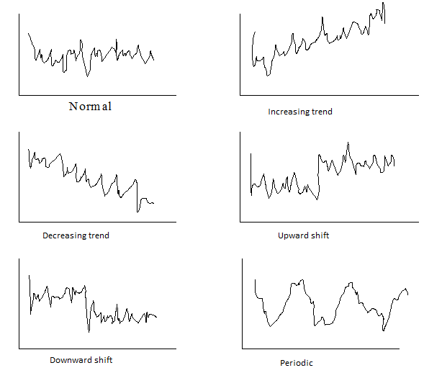
Example 2: Pattern Recognition with LVQ NETWORKS- Patterns

Slide 64
Example 2: Pattern Recognition with LVQ NETWORKS- Generating Pattern
Normal pattern:
Where y(t) indicates temperature at time t.
μ expected temperature
r(t) normally distributed random number at time t.
σ standard deviation
Values for the case study presented here
μ = 80
σ = 5
Generating normally distributed random number using u (uniformly distributed random number).

Slide 65
Example 2: Pattern Recognition with LVQ NETWORKS- Generating Pattern
Trend Pattern:
Where g indicates the slope of trend which is randomly chosen in the range of 0.2 to 0.5

Slide 66
Example 2: Pattern Recognition with LVQ NETWORKS- Generating Pattern
Shift Pattern:
Where k indicates the shifting position. k has a value of 0 before shifting position and becomes 1 afterwards.
S indicate the amount of shift which is taken randomly between 7.5 and 20.

Slide 67
Example 2: Pattern Recognition with LVQ NETWORKS- Generating Pattern
Periodic Pattern:
where, α indicates the magnitude of periodic patterns, and defined randomly by less than 15. T is the number of data which is equal to 60.

Slide 68
Example 2: Pattern Recognition with LVQ NETWORKS- Generating Example
Total of 1500 (250 of each) pattern is randomly generated.
Each example is viewed by eyes for suitability.
The sample set is divided into 2 sets.
Learning set: 498 (83 of each) patterns are used to train the network
Testing set: 1002(167 of each) patterns are used to test the network.

Slide 69
Example 2: Pattern Recognition with LVQ NETWORKS- Topology

Slide 70
Example 2: Pattern Recognition with LVQ NETWORKS- Network Parameters
Parameter | Value
Process elements in Kohonen layer for each category | 6
Initial values (randomly generated) | Between -0.1 and 0.1
Input scaling | Between 0-1
Learning coefficient | 0.05
B constant | 0.0001
C constant | 10

Slide 71
Example 2: Pattern Recognition with LVQ NETWORKS-Result
LVQ | # of iteration | Learning Performance (%) | Testing Performance (%)
Standard LVQ | 70 | 95.18 | 92.31
LVQ2 | 4 | 94.31 | 89.62
Standard LVQ + LVQ2 | 74 | 96.18 | 92.61
LVQ conscience | 70 | 95.98 | 92.71
LVQ-X | 20 | 100.00 | 97.70

Slide 72
QUESTIONS
?
THANK YOU VERY MUCH

